Slide 1
Introduction To Blockchain

Slide 2

About Me
Head of Blockchain in Agmo Studio Sdn Bhd
Blockchain project involved:
GetCoinApp
First Malaysia BTC Broker (Bank Negara Malaysia Approved)
Blockchain Electronic Health Record
I started my career as server developer.
Involved in industrial financial system
Hedging
Stock Market Prediction
Jia Hui
Head of Blockchain

Slide 3
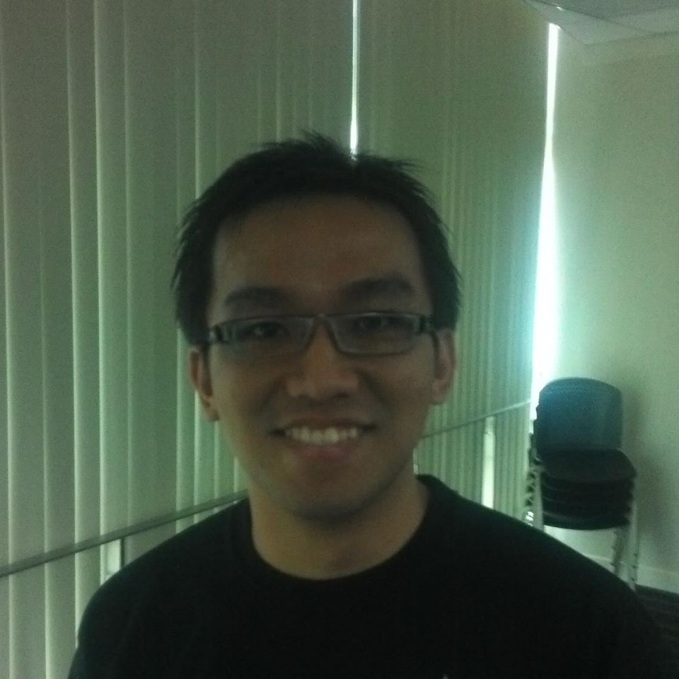

Today’s Team
Jia Hui
Trainer
Steven
Keng Ye
Assistant
Assistant

Slide 4
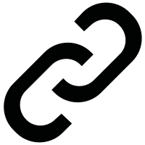
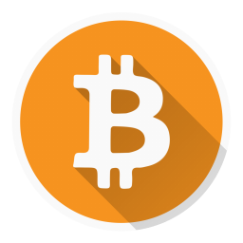
Blockchain Very Important Concept
≠
Blockchain
is not
Bitcoin

Slide 5
Blockchain - a distributed ledger with consensus algorithm.

Slide 6
Blockchain Characteristics
- Distributed ~ (Everywhere)
- Immutable ~ (Unable to change)
- History
- Secure ~ (Un-hackable)

Slide 7
Blockchain Ledger

Slide 8
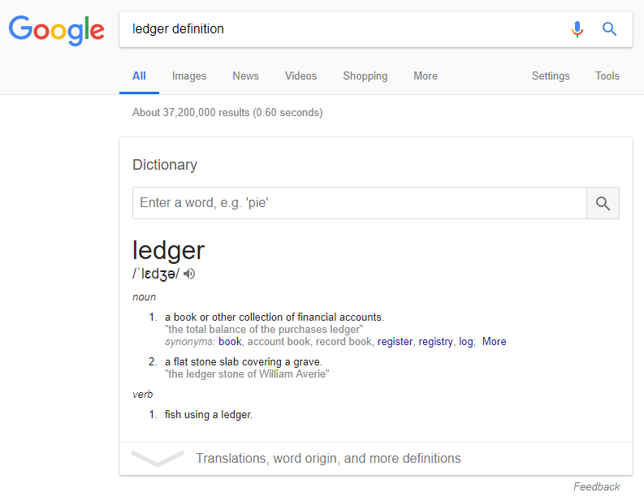

Slide 9
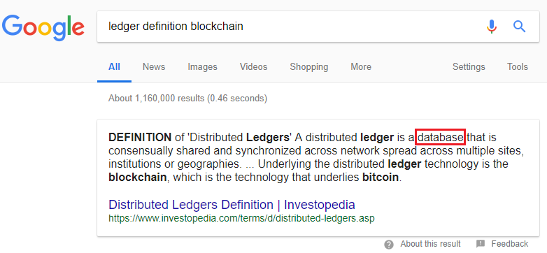

Slide 10
In a Blockchain world Ledger = Database

Slide 11
Why is it called Ledger but not Database?

Slide 12
Database vs Blockchain Ledger
Database | Blockchain Ledger
Insert | Insert
Update | No Update Operation
Delete | No Delete Operation

Slide 13
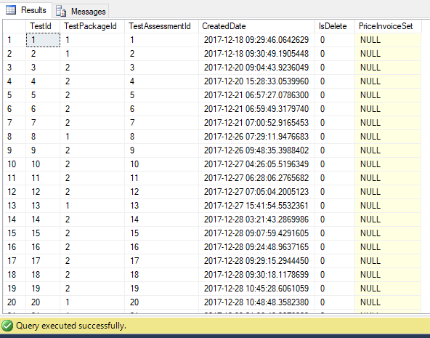
Database

Slide 14
Blockchain Ledger
1
2
3
4
5
6
Data-A
Data-B
Data-C
Data-D
Data-E
Data-F
Block #1
Block #2
Block #3
Block #4
Block #5
Block #6
No Parent
Block #1
Block #2
Block #3
Block #4
Block #5
Notes:
Like the name indicates, the blockchain is a chain of blocks that contain information.
A blockchain is a distributed ledger that is completely opened to anyone.
They have a very interesting property. Once a data had been recorded inside the blockchain it become very difficult to change it.
So how does that work?

Slide 15
Block
- Have data
- Have it’s own identity
- Have parent’s identity
Data
My Identity
Parent’s Identity

Slide 16
How to calculate identity?
- SHA256 hash algorithm.
- SHA1 hash algorithm.
- MD5 hash algorithm.

Slide 17
Hash
Input
Output
Hash Algorithm
abcd
0x1b29cd96f12

Slide 18
Chain
- Connect blocks
- Hash
1
2
3
Data
Data
Data
My Hash
My Hash
My Hash
Hash
Parent Hash
Parent Hash

Slide 19
Why use ledger instead of database?
Once data is added, it is impossible to change.
Once data is added, it cannot be deleted.

Slide 20
Experience Blockchain Ledger
https://github.com/AgmoStudioSdnBhd/BlockchainDemo

Slide 21
Blockchain - a distributed ledger with consensus algorithm.

Slide 22
Database
Have block and chain
Linked together by hash
Blockchain - a distributed ledger with consensus algorithm.

Slide 23
Blockchain Characteristics
- Distributed ~ (Everywhere)
- Immutable
- History
- Secure
Ledger

Slide 24
Distributed Network

Slide 25
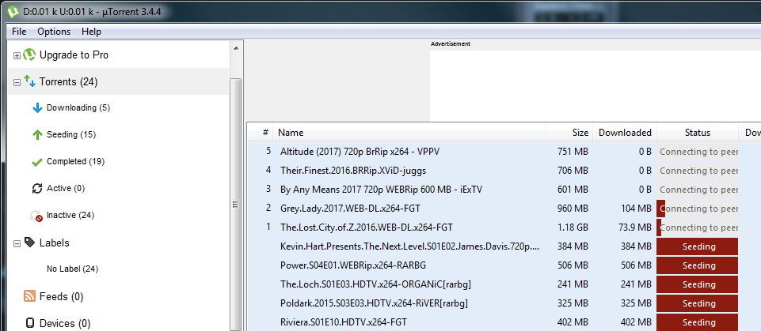
Distributed Network (P2P Network)

Slide 26
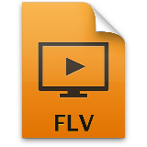






Distributed
Torrent
Network

Slide 27
Distributed Ledger

Slide 28
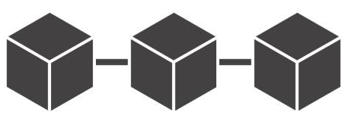
Distributed
Ledger
Network

Slide 29
What is so good being distributed?

Slide 30
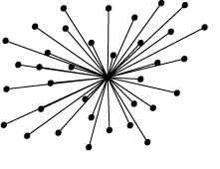
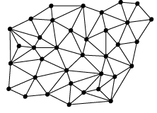
Centralized vs Distributed
Centralized
distributed

Slide 31
Centralized vs Distributed
Centralized
Distributed
Data are stored in one server
Data are not secure
Data are stored in every nodes
Data are secure

Slide 32
Blockchain Characteristics
- Distributed
- Immutable
- History
- Secure
Distributed

Slide 33
Actually if you remember

Slide 34
Blockchain Characteristics
- Distributed
- Immutable
- History
- Secure
Distributed
Ledger

Slide 35
Why Blockchain instead of Distributed Ledger?

Slide 36
Many nodes instead of one server.
Secure
Database
Have block and chain
Linked together by hash
Blockchain - a distributed ledger with consensus algorithm.

Slide 37
Consensus
a fault-tolerant mechanism that is used in computer and Blockchain systems to achieve the necessary agreement on a single data value or a single state of the network among distributed processes or multi-agent systems. It is useful in record-keeping, among other things.

Slide 38
Consensus (TL;DR)
Making everyone happy.

Slide 39
Without consensus in a distributed ledger

Slide 40

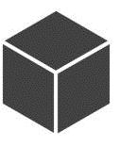
Hey guys, add this green block to your ledger
Ok lor
Don’t want. Tell me why?
Distributed
Ledger
Network
Hmm.. I follow the handsome guy over there
What to eat later?
Notes:
Blockchain is a distributed ledger. Which means everyone in the network keeps a copy of the ledger.
If your ledger is lack of one block, you will automatically get it from any peers on the network.
This technology is called P2P network.
The concept is the same as torrent. [Do you guys know torrent?]
You can share your files on any torrent network and any peers can grab the file from you.
Blockchain works in similar concept, but instead of files, blockchain synchronize ledger among all the peers.

Slide 41
How to make everyone happy?

Slide 42
Consensus Algorithm
Proof of Work
Proof of Stake
Proof of Elapsed Time
Proof of Storage

Slide 43
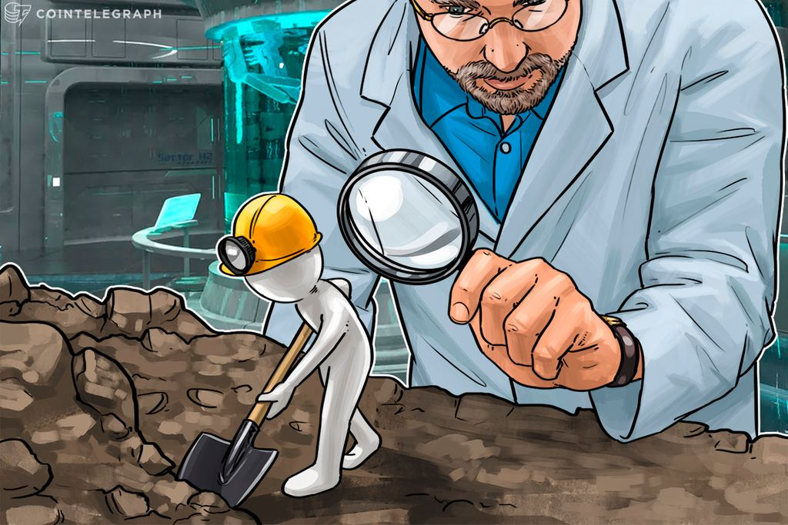
Proof of Work (PoW)
A Consensus algorithm
Used to confirm transactions
Produce new blocks to the chain
Have miners

Slide 44
Distributed
Network

Slide 45
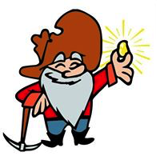
Hey, I found a new block
Distributed
Network
Notes:
So one miner found a new block and he wants everyone to add the new block to their chain so that he can get the reward (12.5 BTC).
The new block will be broadcast to the blockchain network.

Slide 46
Hey, I found a new block
Distributed
Network
Notes:
Every peer will then check the previous hash, the nonce, to make sure the block is valid.
If everything in the new block is OK, then everyone will connect the new block to their chain.

Slide 47
Distributed
Network
Notes:
This create consensus in the Blockchain network.
Remember in previous slide, we talk about consensus and mining?
Miner’s job is to work hard and makes everyone connect the block into their chain.

Slide 48
In PoW consensus algorithm, only the miner can make everyone happy to add new block.

Slide 49
But remember, PoW is only one of an example to make everyone happy.

Slide 50
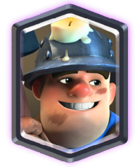
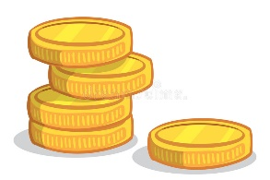
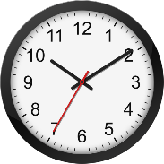
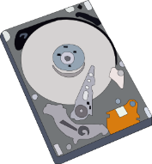
Consensus Algorithm
Proof of Work
Proof of Stake
Proof of Elapsed Time
Proof of Storage

Slide 51
Experience Mining
https://github.com/AgmoStudioSdnBhd/BlockchainDemo

Slide 52
Many nodes instead of one server.
Secure
Database
Have block and chain
Linked together by hash
Blockchain - a distributed ledger with consensus algorithm.
To make everyone happy.
To make sure everyone have the same data.
Have many ways

Slide 53
Blockchain Characteristics
- Distributed
- Immutable
- History
- Secure+++
Distributed
Ledger
Consensus

Slide 54
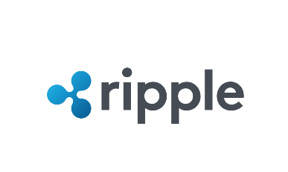



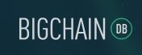
Type of Blockchain
Public
Private
Permission-less
Permissioned

Slide 55
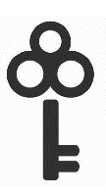
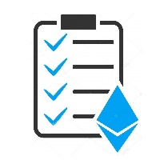

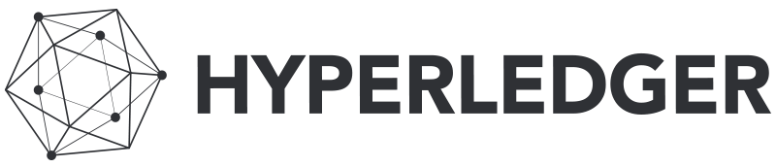


Evolution of Blockchain
Industry Use
Code
Currency
Blockchain 3.0
- Industry Blockchain
Blockchain 2.0
- Smart contracts
Blockchain 1.0
- Simple ledgers that
record transactions

Slide 56
Blockchain Use-Cases
UTAR – Blockchain Graduation Certificate
Source : https://www.utar.edu.my/deas/index.jsp?fcatid=388&fcontentid=1878&f2ndcontentid=191345
Blockchain Property Management – Swedish
Source: https://cointelegraph.com/news/swedish-government-land-registry-soon-to-conduct-first-blockchain-property-transaction

Slide 57
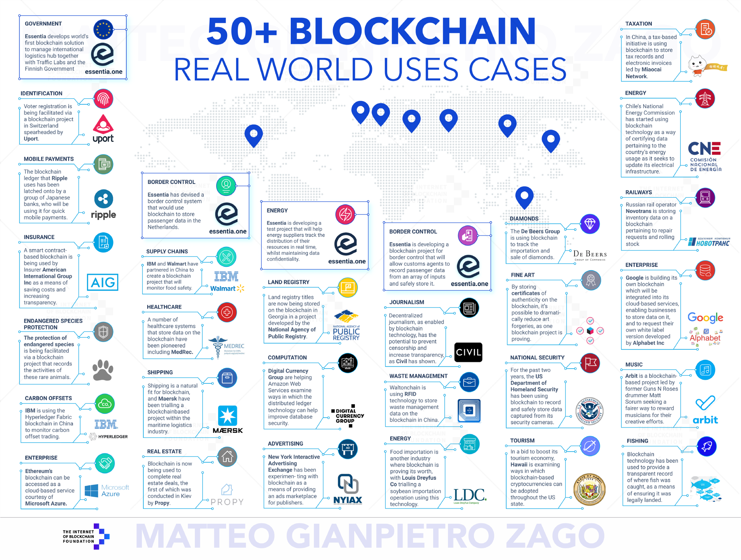
Use-case

Slide 58
Thank you

